Slide 1
Outlet Sales Predictions
By Bijan Emadi

Slide 2
Data Overview
Variable Name | Description
Item_Fat_Content - Whether the product is low fat or regular
Item_Visibility - Percentage of total display area of all products in a store allocated to the particular product
Item_Type - Category to which a product belongs
Item_MRP - Maximum retail price of an item
Outlet_Identifier - Unique store ID
Item_Outlet_Sales - Sales of the product in a particular store - variable to be predicted.

Slide 3
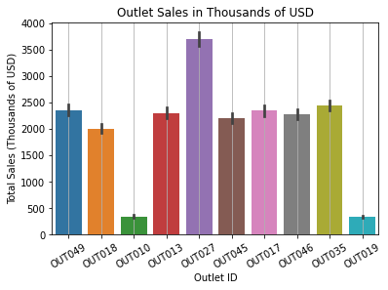
Statistical Analyses
Outlet 27 has the highest sales by far
Outlets 10 and 19 have the lowest by far
Let’s explore some the differences between these outlets.

Slide 4
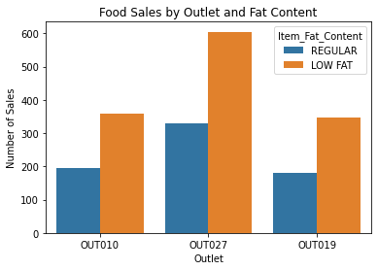
Statistical Analyses
Outlet 27 has the highest raw number of sales
Low fat items consistently outsell regular items
Each of the outlets has roughly the same ratio.

Slide 5
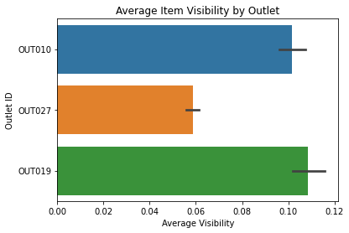
Statistical Analyses
Average item visibility at Outlet 27 is lower overall
High item visibility is not a good indicator of sales.

Slide 6
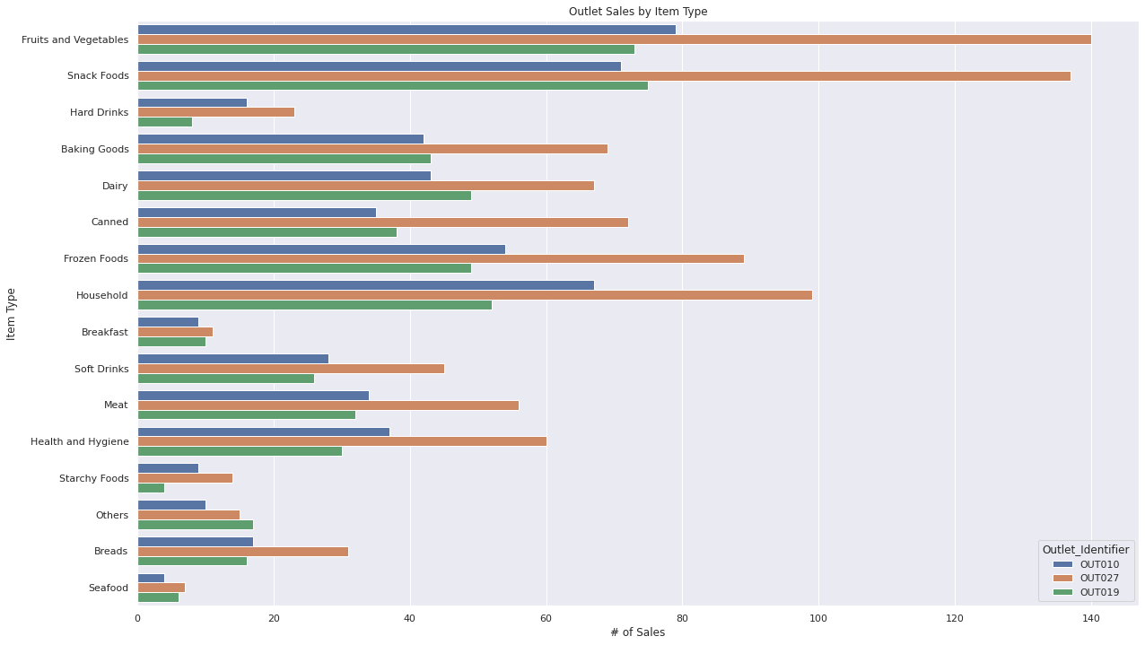
Statistical Analyses
Fruits and vegetables and snacks are the most popular items by far
Outlet 27 has the highest sales in each category except ‘others’, which outlet 19 leads

Slide 7
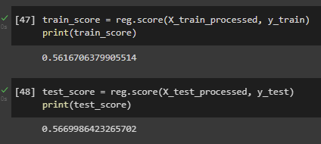
Preprocessing and Regression Modelling
Linear regression scores :

Slide 8
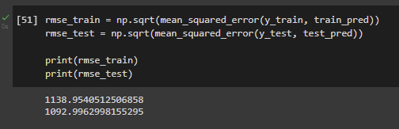
Preprocessing and Regression Modelling
Root mean squared errors :

Slide 9
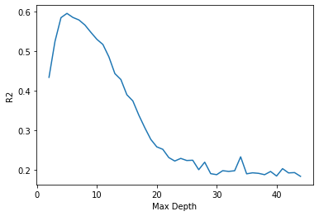
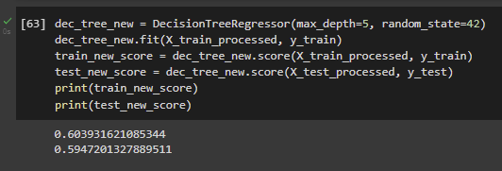
Regression Tree Model
This line indicates the ideal maximum depth for fitting our model (5)
We can be confident this is the best fit for our data.
R2 scores vs Max Depth

Slide 10
Final Insights
Some of the features are not as reliable at indicating sales numbers as one may expect.
Lower average item visibility may be an indicator that the outlet is larger or has a larger inventory and therefore each individual item is less noticeable.
Our regression tree model is best suited for predicting outlet sales.

